Slide 1
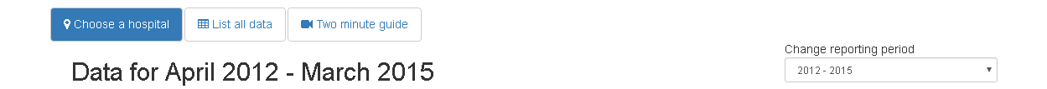
Explore the data
In this section you can explore the overall hospital survival statistics published by the National Congenital Heart Disease Audit (NCHDA). The data covers all hospitals in the UK and Ireland that performed heart surgery in children (0-16 years old). NCHDA update the data annually and each report covers a 3 year period.
Use the drop down box to change reporting periods. You can watch our two minute guide which explains how we present the statistics and how to interpret them. Parents who helped us develop the website found this guide useful for interpreting the data.
All data on this site comes from the NCHDA annual reports, all of which can be downloaded from the NCHDA website.
Hospital data for April 2012 – March 2015
Choose a hospital from the list or the map to see its data.

Slide 2
Explore the data
In this section you can explore the overall hospital survival statistics published by the National Congenital Heart Disease Audit (NCHDA). The data covers all hospitals in the UK and Ireland that performed heart surgery in children (0-16 years old). NCHDA update the data annually and each report covers a 3 year period.
Use the drop down box to change reporting periods. You can watch our two minute guide which explains how we present the statistics and how to interpret them. Parents who helped us develop the website found this guide useful for interpreting the data.
All data on this site comes from the NCHDA annual reports, all of which can be downloaded from the NCHDA website.
List all data for April 2012 – March 2015
This list summaries the data for each hospital. Clicking on a hospital code will bring up specific information for that hospital along with an interpretation of its survival rate. It is only valid to compare a hospital's survival rate to its predicted range of survival and not to other hospitals. Read more about this in Everything Else.
The Everything Else section also tells you more about the predicted range and what happens if a hospital’s survival rate is outside its range.
You can use your mouse to hover over the chart to bring up more explanation.

Slide 3
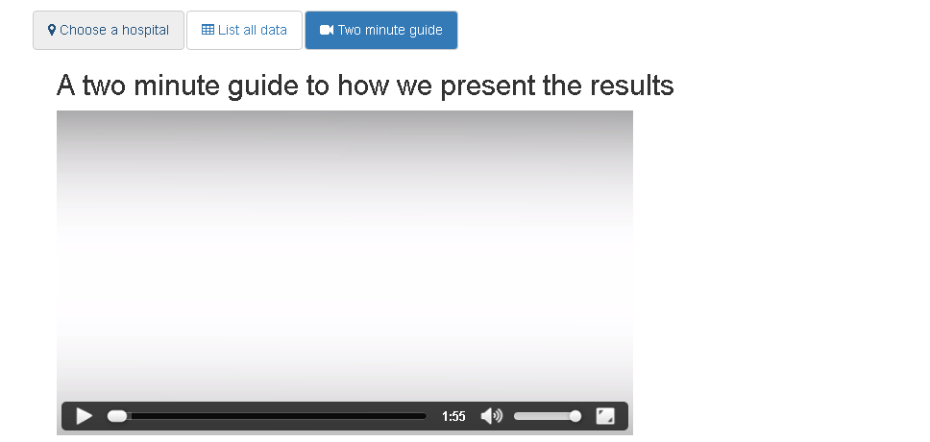
Explore the data
In this section you can explore the overall hospital survival statistics published by the National Congenital Heart Disease Audit (NCHDA). The data covers all hospitals in the UK and Ireland that performed heart surgery in children (0-16 years old). NCHDA update the data annually and each report covers a 3 year period.
Use the drop down box to change reporting periods. You can watch our two minute guide which explains how we present the statistics and how to interpret them. Parents who helped us develop the website found this guide useful for interpreting the data.
All data on this site comes from the NCHDA annual reports, all of which can be downloaded from the NCHDA website.
Parents who helped us develop the website found this guide useful for interpreting the data. If you want to know more about how the predicted range of survival is actually calculated, please watch our second video in the Everything Else section.
TWO MINUTE GUIDE ON HOW WE PRESENT THE RESULTS

